Slide 1
ACS Functionality

Slide 2
Objectives
List ACS functional capabilities

Slide 3
Federation and Trust
ACS implements federation and trust using industry standards
Protocols:
WS-Trust
WS-Federation
OAuth WRAP and OAuth 2.0
Token formats:
SAML 1.1 and 2.0
SWT

Slide 4
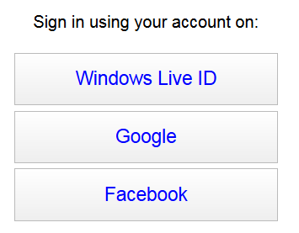
Authentication
Built in login pages
Cannot be customized
Home Realm Discovery Metadata Feed
Enables page customization

Slide 5
Authorization
ACS’ Rules Engine
Control what claims get into the token
Management portal
Identity providers
Windows Identity Foundation (WIF)
Role-based access control (RBAC)
Claims-based authorization

Slide 6
Administration
Administer ACS via its Management Portal
Accessed through Windows Azure portal
Administer ACS via Management Service
A service that exposes OData endpoint
Does not required client SDK
Automation
Custom UI
Functionality not available via Management Portal

Slide 7
Key Takeaways
ACS implement industry standards
ACS offers flexible authorization options
ACS can be managed manually and programmatically

Slide 8
Next Steps
Sign up for free trial at http://www.microsoft.com/windowsazure/free-trial/
Learn more at http://go.microsoft.com/fwlink/?LinkID=212360

