Slide 1
What’s ACS?

Slide 2
Objectives
Scope what ACS is
Where to learn more

Slide 3
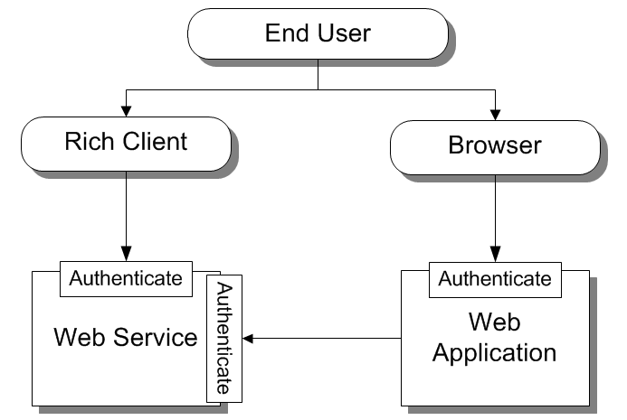
Traditional Authentication

Slide 4
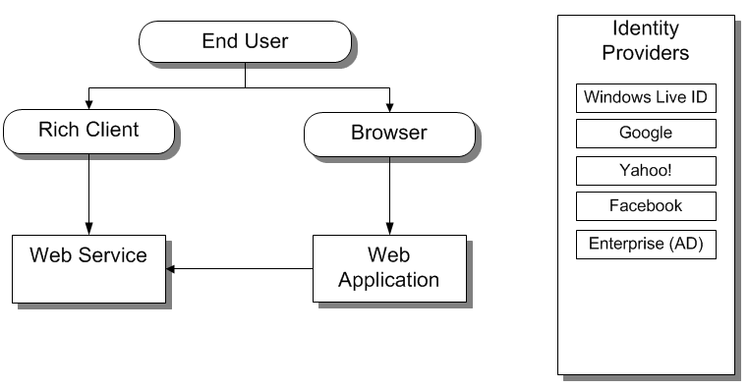
Challenge

Slide 5
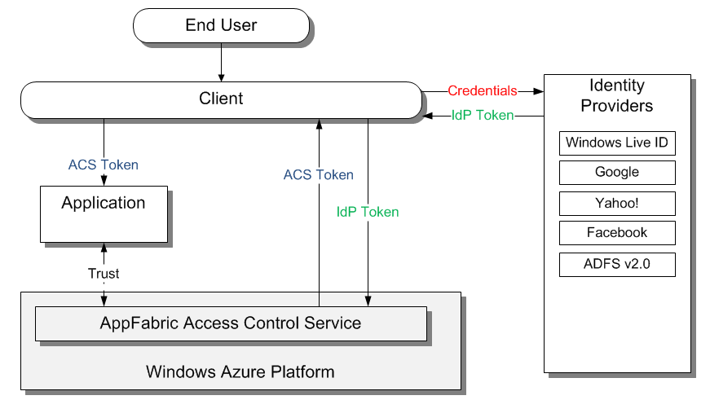
Authentication with ACS

Slide 6
Key Takeaways
ACS is part of MS Windows Azure platform cloud offering
ACS factors out authentication of your application

Slide 7
Next Steps
Sign up for free trial at http://www.microsoft.com/windowsazure/free-trial/
Learn more at http://go.microsoft.com/fwlink/?LinkID=212360

