Slide 1
ACS and WIF

Slide 2
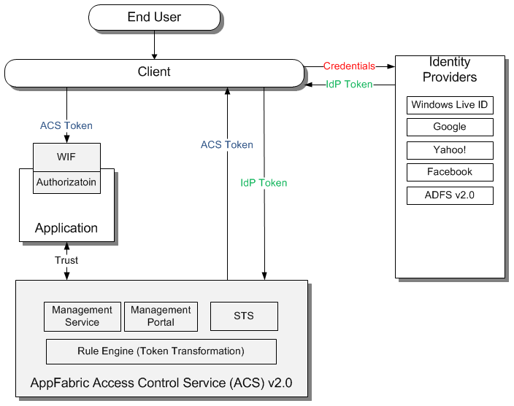
Objectives
Clarify ACS and WIF relationship

Slide 3
Cloud Service vs. .Net Assembly
ACS is a Cloud Service
Part of Windows Azure Platform
WIF is a .Net runtime
Runs as part of your web application or service.
Free out of band download

Slide 4
ACS - Protocol Handling
ACS does heavy lifting for handling protocols
WS-Federation
WS-Trust
OpenID
OAuth 2.0, OAuth WRAP
Facebook Graph
ACS issues normalized tokens
SAML
SWT

Slide 5
WIF - Token Parsing, Tooling
Parses incoming tokens
Exposes convenient .Net API
Design Time tooling via FedUtil wizard tool
Extensibility points:
Configuration sections
Custom token handlers
Authorization
Role based and claims based

Slide 6
Key Takeaways
ACS is a cloud service
WIF is .Net runtime
Heavy lifting for handling protocols and tokens
Runtime and design time

Slide 7
Next Steps
Sign up for free trial at http://www.microsoft.com/windowsazure/free-trial/
Learn more at http://go.microsoft.com/fwlink/?LinkID=212360

