Slide 1
ACS Deployment Scenarios

Slide 2
Objectives
List key deployment scenarios

Slide 3
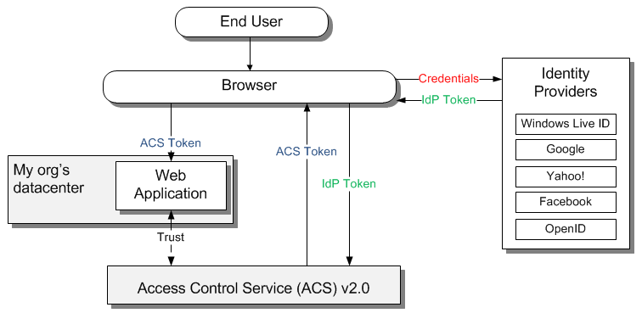
On-premises Web Applications
“I want to allow Facebook users to login to my organization’s web application”

Slide 4
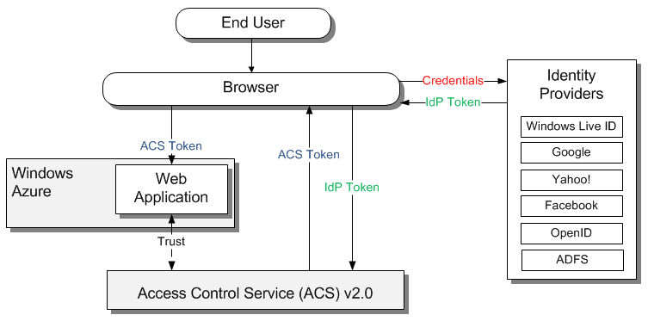
Windows Azure: Web application
“I do not want to invest in new identity management systems, want to let Internet or employees users login to my web app”

Slide 5
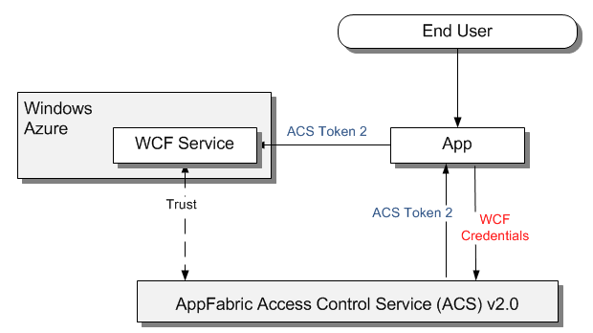
Windows Azure: Web Service
“I do not want to implement authentication and identity management for my web service in the cloud”

Slide 6
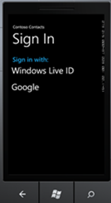
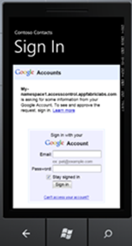
Mobile Devices
“How to login to Windows Live ID or Google on my Windows Phone 7 app?”

Slide 7
Key Takeaways
ACS is a cloud service
ACS can serve cloud deployed apps
ACS can serve on-premises apps
ACS can serve mobile devices apps

Slide 8
Next Steps
Sign up for free trial at http://www.microsoft.com/windowsazure/free-trial/
Learn more at http://go.microsoft.com/fwlink/?LinkID=212360

