Slide 1
What ACS Can Do For Me?

Slide 2
Objectives
List core functionality of ACS v2

Slide 3
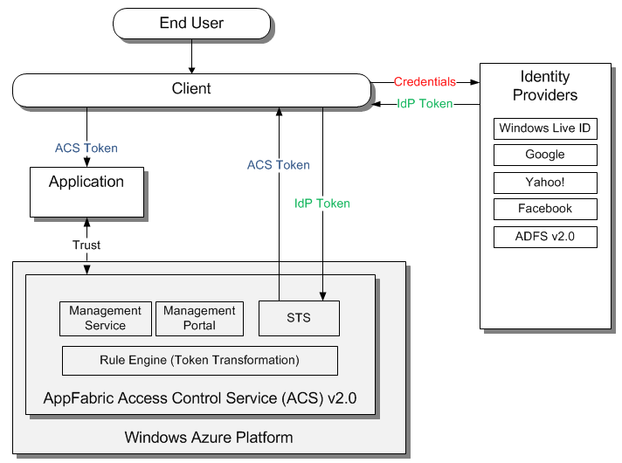
Federation with Internet identity providers

Slide 4
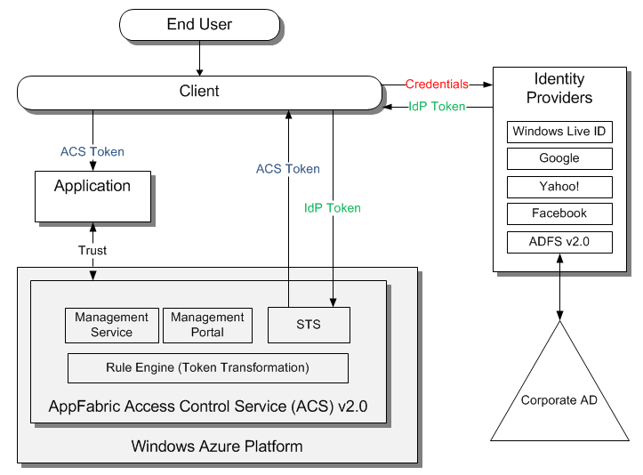
Federation with corporate identity providers

Slide 5
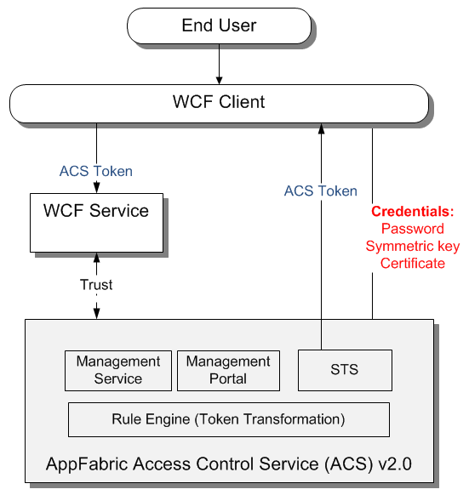
Manage credentials for Web services

Slide 6
Key Takeaways
Outsource authentication to industry mature identity management systems
Reuse investment in corporate identity management systems
Works for Web and Web services architectures

Slide 7
Next Steps
Sign up for free trial at http://www.microsoft.com/windowsazure/free-trial/
Learn more at http://go.microsoft.com/fwlink/?LinkID=212360

