Slide 1
ACS and the Cloud

Slide 2
Objectives
Map ACS to different flavors of the Cloud

Slide 3
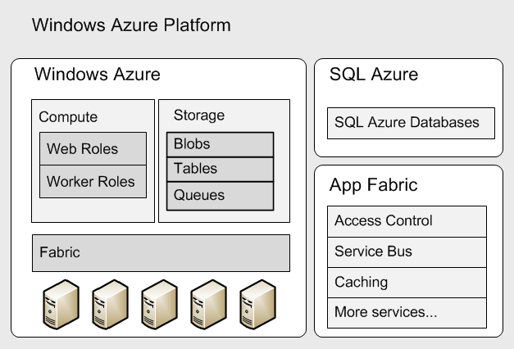
ACS and Windows Azure Platform
ACS is a cloud service
ACS is part of Windows Azure Platform
A service within AppFabric

Slide 4
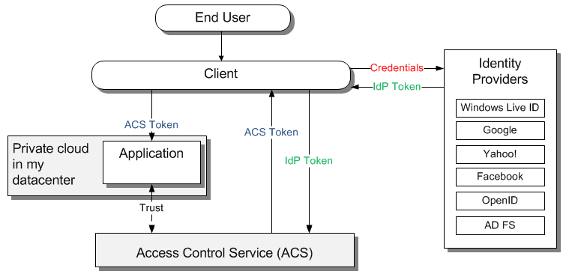
ACS and Private Cloud
Private Cloud
On-premises
Notes:
Scenarios
Customers log in using Live ID, Facebook, Google, Yahoo! identities
Mobile employees log in using Active Directory credentials

Slide 5
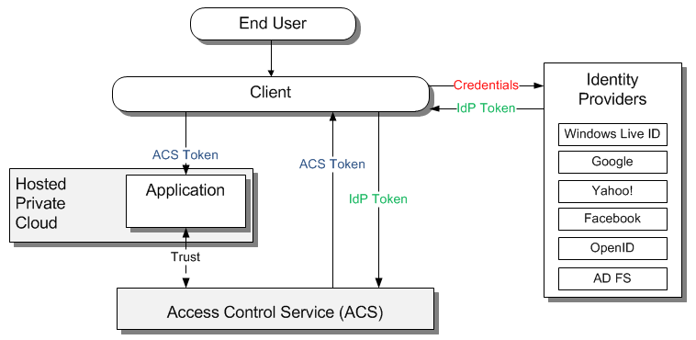
ACS and Private Cloud
Private Cloud
Hosted
Notes:
Scenarios
Customers log in using Live ID, Facebook, Google, Yahoo! identities
Mobile employees log in using Active Directory credentials

Slide 6
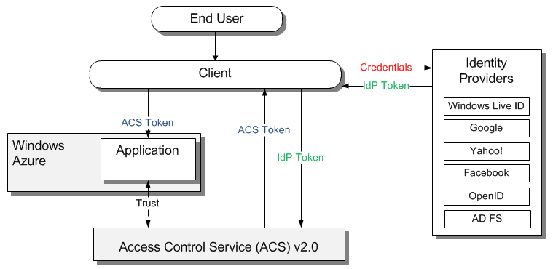
ACS and PaaS
Platform as a Service
Windows Azure Platform
Notes:
Scenarios:
Web App on Windows Azure uses ACS
Web Service on Windows Azure uses ACS
ACS is not limited to consumption by Windows Azure deployed apps any modern app platform hosted on PaaS cloud providers can consume ACS

Slide 7
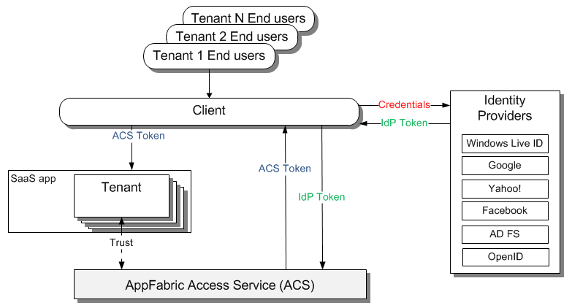
ACS and SaaS
Software as a Service
Custom built multitenant application
Notes:
Scenarios:
“To run my business I offer SaaS app”
Use Management Service for onboarding your tenants

Slide 8
Key Takeaways
ACS is a Cloud service
ACS can serve Private Cloud needs
ACS can serve PaaS Cloud needs
Not limited to Windows Azure Platform
ACS can serve SaaS Cloud needs
Use Management Service for onboarding your tenants

Slide 9
Next Steps
Sign up for free trial at http://www.microsoft.com/windowsazure/free-trial/
Learn more at http://go.microsoft.com/fwlink/?LinkID=212360

