Slide 1
ACS Architecture

Slide 2
Objectives
List ACS key components

Slide 3
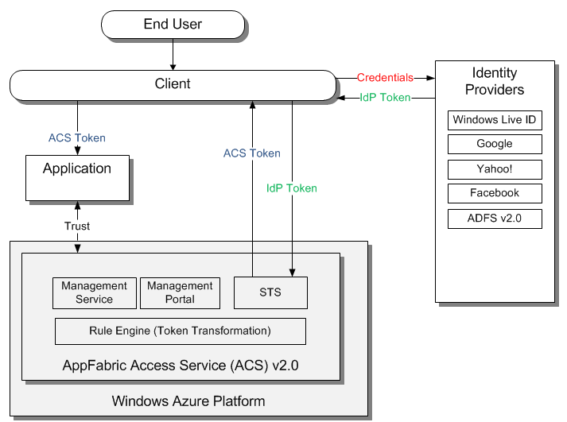
STS – Security Token Service

Slide 4
Management Portal

Slide 5
Management Service

Slide 6
Token Transformation Rule Engine

Slide 7
Key Takeaways
ACS is a cloud service
STS (Security Token Service) - issues security tokens
Management service – API for administration automation
Management portal – user interface for ACS administration
Rule engine – rule driven security token transformation

Slide 8
Next Steps
Sign up for free trial at http://www.microsoft.com/windowsazure/free-trial/
Learn more at http://go.microsoft.com/fwlink/?LinkID=212360

